Slide 1
Post-Cutover to Interval Billing Deep Dive Workshop
02/18/2014

Slide 2
Agenda
Opening Remarks
Who's Here
Review Previous Workshop Outcomes
Process Drill Downs
This week we will cover Complex Billing Processes
Next week we will cover Device Management
Analytics/ Business Reporting & Performance Expectations
Requirements Captured
Review Action Items
Participants Needed for Next Workshop
Wrap Up and Next Steps

Slide 3
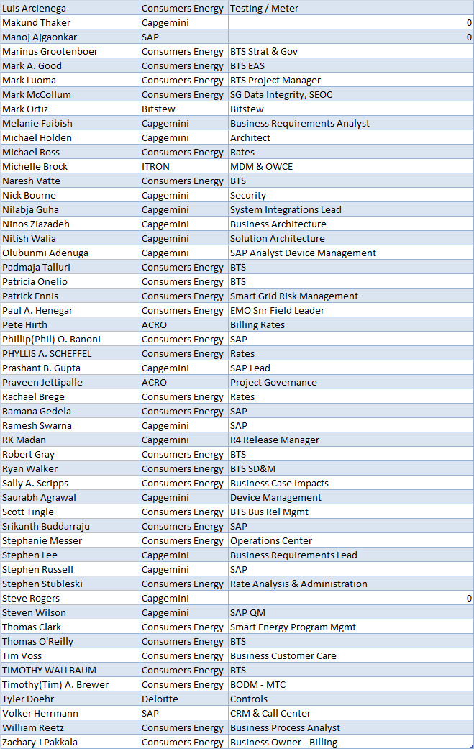
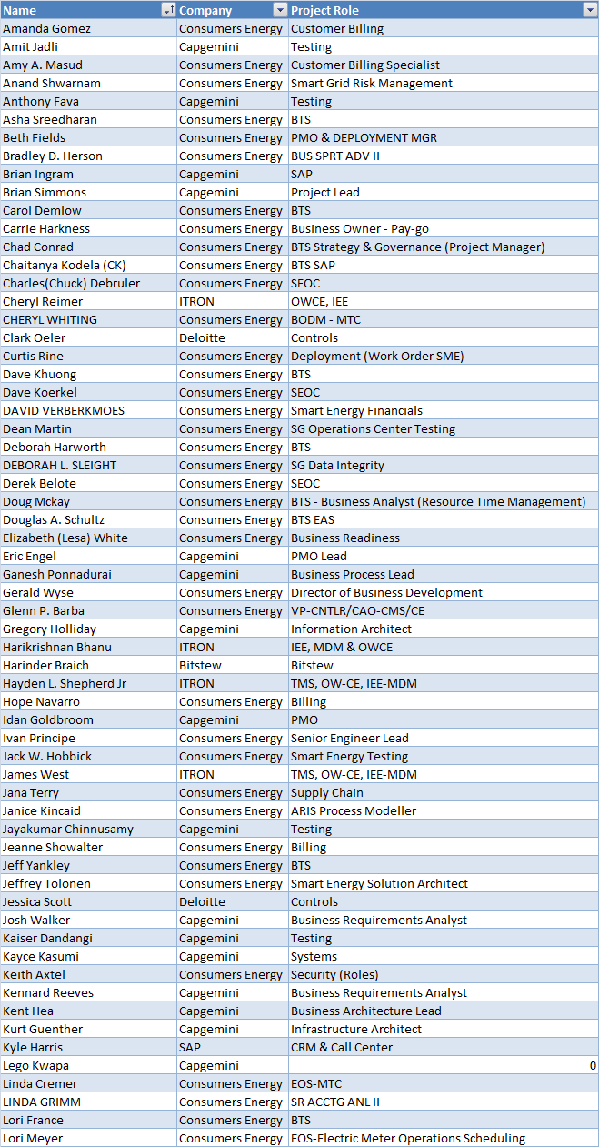
Deep Dive Attendees

Slide 4
Scope Assumptions for Post-Cutover to IB– R4
In Scope
Interval Data will be store in the MDM for 84 months
60-Minute intervals for Residentials; 60 or 15 -minute for Commercial & Industrials not billing on demand
15-minute for Commercial & Industrial when demand billed (nothing less than 15-minute when demand billing)
ODR (On Demand Read) will always be index based and will not relate to interval reads
Complex billing determination is performed in MDMS with distinct determinants back to SAP billing system (for interval billing)
Small commercial customers are GS and GSD and customer choice rates. Large commercial customers are GP, GPD and customer choice rates (generally billed off MV90 metering).
There are limitations of up to 7 meter registers in the Openway Head End
Changes to functional groups require a meter swap (OTA config group/function -- Meter program)
Gap-fill interrogation (an extension of VEE) – “will need to be turned on for interval billing”
ITRON advised to choose a limited numbers of validations for R4 based on the number of resources currently available within MDM; hence few validation checks were selected. High/low will be done at some point in the future
Changes are required to the technical master data within both SAP and IEE support the interval billing process, namely the creation (ties to install/remove/replace processes), allocation to the register, and replication of interval “profiles”
Appropriate SAP and IEE rate configuration changes, development of formulas are required to allow for interval billing determinant requests
Complex billing determination is performed in MDMS with distinct determinants back to SAP billing system (for interval billing)
Only RS and GS Customers can Opt Out of AMI Metering. GSD Customer cannot Opt Out.
A question came up about GSD customers being able to opt out.
Below is a confirmation from Phyllis stating that according to the current tariff only RS and GS customers can opt out. A while back I also checked with Rachel from the Rates Department and asked her if GSD customers could opt out and she said no.
No residential customers will use interval billing in R4 (it is anticipated that interval consumption reads for Residential will be covered in R5 when Time Of Day rates will be introduced)
Interval billing is available to customers who bill OTA and any customer that signs up for a program requiring interval billing
It was noted that all residential and commercial & industrial customers that have intervals stored in MDM have AMI meters
It was noted that only max demand and power factor will move to interval reads for billing
No residential customers will use interval billing in R4 (it is anticipated that interval consumption reads for Residential will be covered in R5 when Time Of Day rates will be introduced)
Unless used on a demand rate
Meter Reading & VEE is required for interval OTA Billing
Gap Fill & Estimation is required for interval OTA billing
Cutover for max demand/power factor from manual to interval OTA is in scope

Slide 5
Scope Assumptions for Post-Cutover to IB– R4
Out of Scope
Gas Metering & Estimation
Gas module won’t be deployed until Q3 2014 and this is with Centron via Openway and assuming not through TMS
Customer Enrollment & Outreach Channels for DLA & DPP
Electric or Gas Register Billing
Customer Selects Due Date (for Bill)
TOU – Residential
The existing deployed meters have register channels that are pre-programmed according to the current TOU time periods and thereby Consumers Energy has some flexibility with respect to how many TOU rate categories are migrated over to using interval data as part of the billing calculations. Time of use is supported through on/off registers -- Multiple TOUs scheduled, based on the rate (On-peak, mid-peak, off-peak) will be through different registers <- TOU is supported in R5
On/Off peak or High/Med/Low
Index rate customers still get interval view on portal
PayGo Program
Data Recovery in the HE
Meter Reading Schedule
Theft Detection (impacting Billing)
Outage Management (impacting Billing)
Remote Turn-On/Offs (impacting Billing)
Net Metering (impacting Billing)
PEV (Plug-In Electric Vehicle)
Customer Selection - Residential and C&I
Customer Migration - Residential and C&I
Moving residential from index OTA to interval OTA based on program enrolled
AMI Meter Deployment (Cutover/Route Closure/HQ Turnover)

Slide 6
VACD Model/Process Models

Slide 7
Requirements

Slide 8
Action Items
What | Due Date | Status | Owner | Comments
Need to have a detailed architectural discussion around what “complex” billing determinants will be calculated by the MDM. Consumers Energy have invested over 15,000 hours (rough estimate) in the complex EDM billing configurations in SAP. There are significant doubts that the MDM can replicate these determinants. Need to also review direction of adding such significant replication of effort when we have other options. | 2/7/2014 | Defer | Tim Wallbaum, Zach Pakkala | To be discussed as an Offline Topic – Does this need to be a BP Policy Meeting Concern?
What happens in the case where the MDM doesn’t have anchor reads, and there are missing intervals? How is the ending index going to be generated? | 2/7/2014 | Open | Pete Hirth, Cheryl Reimer, Tim Wallbaum | MDM will estimate the missing interval. How will the 3-day window work with interval billing? PJH: 2/7/2014 – This will need to be discussed in the upcoming IEE Estimation Focus Group meeting concerning VEE in the MDM. I believe this meeting will be scheduled by Capgemini – Need to identify who will coordinate this meeting from the Cap team.
Need to discuss the need for EDM profiles for true interval billing. This is not necessary for R4, but it is my understanding that it is a requirement for R5? | 2/7/2014 | Open | Zach Pakkala | Related to MV90 à SAP/MDM configuration IEE needs rates table for this change
Should Grid Director be considered for Rate Analysis? Need to determine what CE will do with Read-Only (Non-Billing) Meters used for Rate Analysis – mini workshop required | 2/7/2014 | Open | TBD | What data needs to be stored in both single phase and polyphase? Rate Analysis Focus Group Discussion to be arranged
Need New Performance Test: Test the OTA meter progress change from 60 min to 15 min. How do we handle cutover (over the air) of the single-phase meters that change rate category to demand from 60-min intervals to 15-min intervals? | 2/7/2014 | Open | Jack Hobbick | Collecting requirements for performance tests New Installer/Rate Change

Slide 9
Action Items
What | Due Date | Status | Owner | Comments
Opt Out – Need to file for all C&I customers opting out of AMI – Need to validate the tariff about the rate categories listed | 2/14/2014 | Open | Zach Pakkala Pete Hirth | Opt out Mechanical RS1000 GS1100, GS1N, R08 Rate categories, GS2100, GS2110 BP Policy Metering PJH: 2/7/2014 – Phyllis Scheffel looked up the Non-Transmitting Meter Provision tariff that was approved in the U-17087 Order and it indicated that Customers served on Residential Service Secondary Rates RS and General Service Secondary Rates GS have the option to choose a non-transmitting meter. I also previously talked to Rachel Brege and she indicated that GSD customers cannot Opt Out of having an AMI meter.
SAP does not use the “read quality code” on MDM data – How should this be resolved? Need to determine what CE will do with Interval Data for VEE in MDM and how will missing intervals will be estimated | 2/14/2014 | Open | Hari Bhanu, James West, Pete Hirth, Nilabja Guha, Bob Jacobs | Look at differences in estimation processes of MV90 vs. MDM In Progress PJH: 2/7/2014 – This will need to be discussed in the upcoming IEE Estimation Focus Group meeting. I believe this meeting will be scheduled by CAP.
Review MV90 cancel/re-bill processes prior to next deep dive | 2/14/2014 | Open | Janice Kincaid Jeanne Showalter, Hari Bhanu, James West | Present results to team Look at stale data extract (ITRON)
Send Create Device Processes and Device Error Handling to Tim Brewer and Paul Henegar | 2/14/2014 | Open | GaneshPonnaduari | Need to verify if these are needed for subsequent deep dives.
What does CE do with Calendar month billing (MV90) customers when missing intervals? Pre-Calendar month customer – excluded in R4? | 2/14/2014 | Open | Pete Hirth Tim Wallbaum | BP policy PJH: 2/7/2014 - MV90 will perform all of the estimations for missing intervals for calendar and non-calendar MV90 interval data when it is uploaded to SAP for the first time. Once the MV90 interval data is in SAP a user can change and modify MV90 interval data directly in SAP (EDM) or MV90 can correct the interval data and re-upload to SAP. Converting MV90 meters that are on customers who bill on calendar month reads will not be part of R4A or R4. It could be addressed in R5

Slide 10
Action Items
What | Due Date | Status | Owner | Comments
Eliminating MV90 to replace with IEE-MDM may not happen, but objective is to minimize MV90 ; Anticipate low volume for “gas” functions, high revenue customers and security issues will keep MV90 from being completely eliminated. When is MV90 being phased out? Complex billing determination is more complicated for C&I –> MV90 or SAP EDM + real-time pricing? |  | Open |  | Policy Question Billing Determininants and Validations
Interval limitation in MDMS implies 4 for single phase and 20 for polyphase (GE). What is the limitation on the Centron polyphase meter (ITRON)? |  | Open |  | Technical Question Interval Billing
Is there a conflict that may exist with the validation rules within SAP and those of MDM? Best way to handle this is not to turn on power outage resulting in mass estimation. |  | Open |  | Policy Question Billing Determininants and Validations
There are 10,000 single phase meters (residential) single phase billed on a demand tariff; Do we plan on having the 10,000 meters pre-programmed for Interval OTA? |  | Open |  | Policy Question Device Management
Does MDM know the diff between missing read and a corrupt read? |  | Open |  | Policy Question Billing Determininants and Validations
Do Net Metering customers need to be considered for complex billing? | 2/7/2014 | Open | Zach Pakkala | Add to Post-Cutover IB - Discuss Offline – FROM PRE-CUTOVER
No MV90 customers were considered for release 3 – should they be considered for release 4? | 2/7/2014 | Open | Ivan Principe | RA consideration - FROM PRE-CUTOVER
How would interval billing positively impact winter summer pricing? Interval reads available. Customer can see in portal | 2/7/2014 | Open | Zach Pakkala | Why won't it do it by default today? - Not every customer will be on interval billing - FROM PRE-CUTOVER
For the future state, how will max demand interval be captured with the new AMI meter? | 2/7/2014 | Open | Zach Pakkala | If AMI meter is manually read, max demand is captured off index read. If read OTA, max demand is captured off highest 15 min interval - FROM PRE-CUTOVER

